Slide 1
CNNs
The Data Bootcamp |
<DATE GOES HERE>

Slide 2

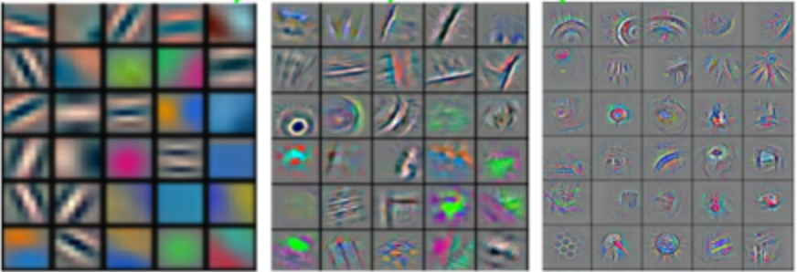
Convolutional Neural Networks
Spatial Features
Bus
Car
...
Image
Labels

Slide 3

Convolutional Neural Networks
Image Src: https://www.mathworks.com/discovery/convolutional-neural-network.html

Slide 4
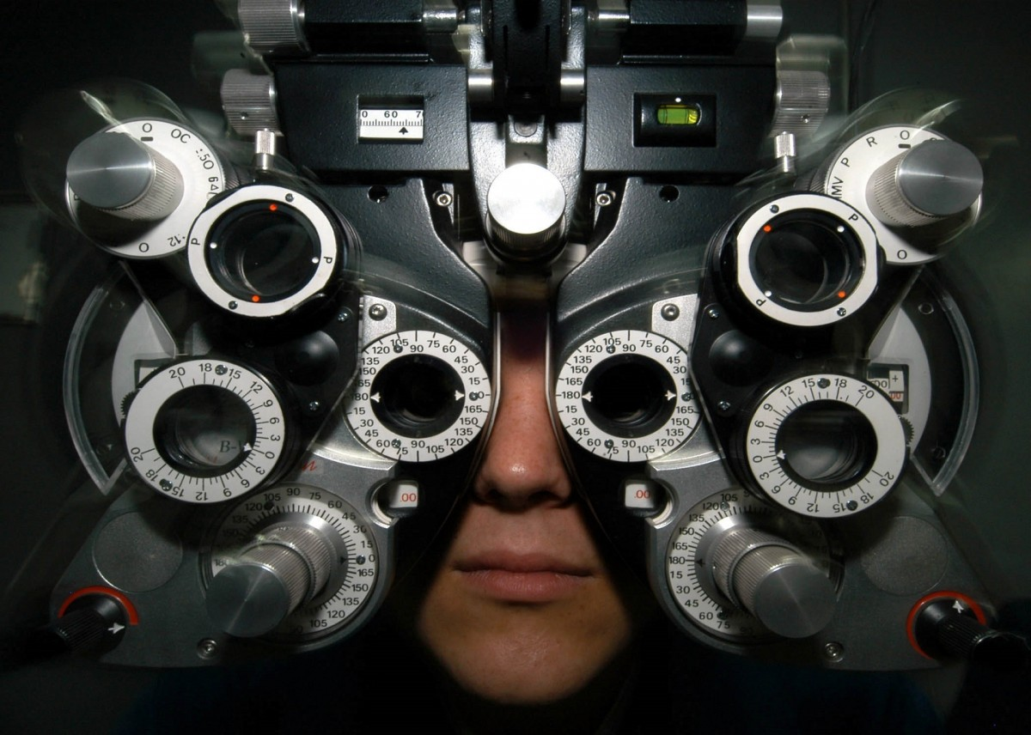
CNN Filters

Slide 5
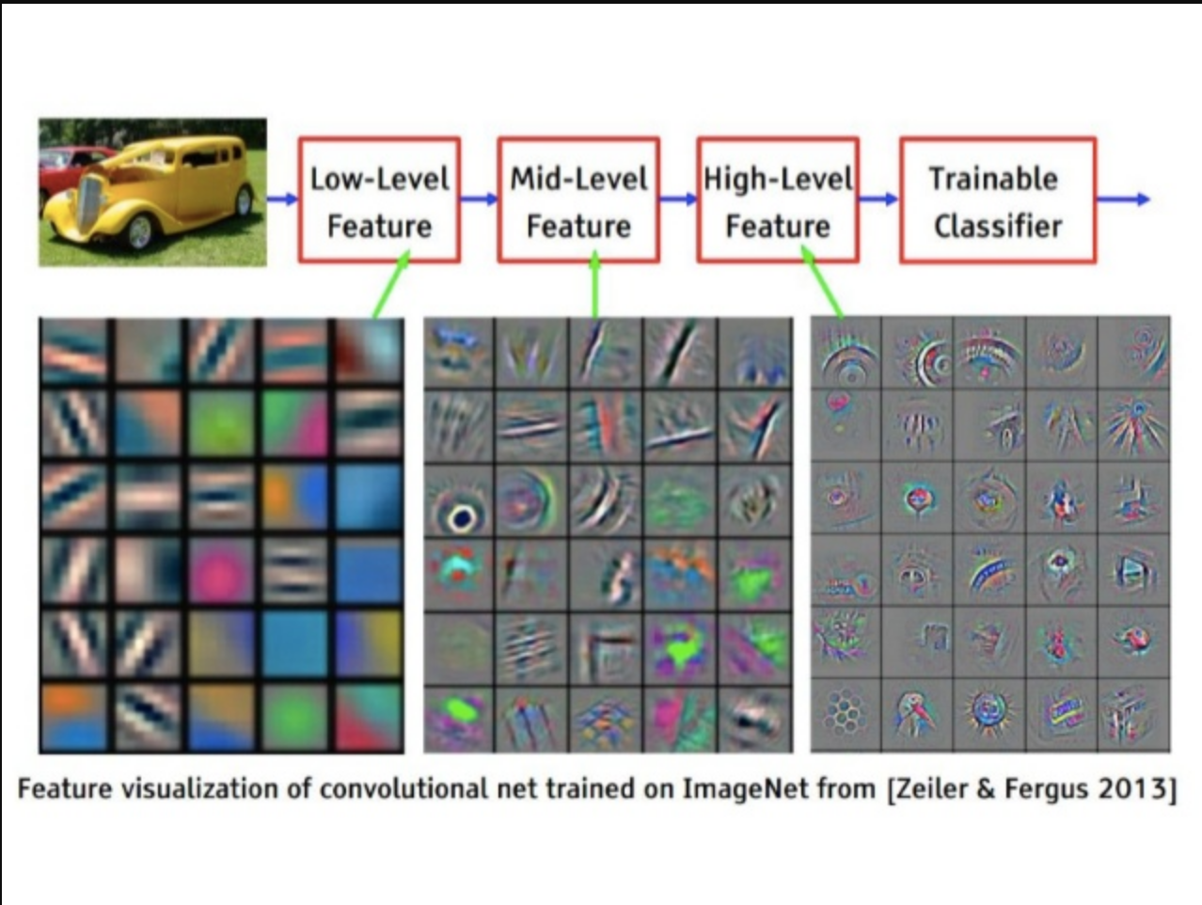
CNN Filters

Slide 6
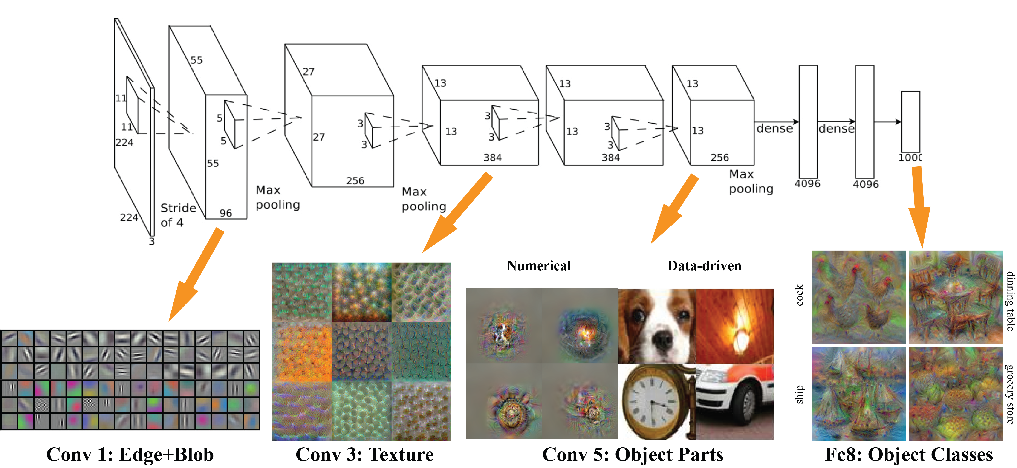
CNN Filters

Slide 7
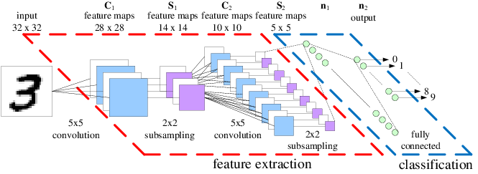
CNN Architecture

Slide 8
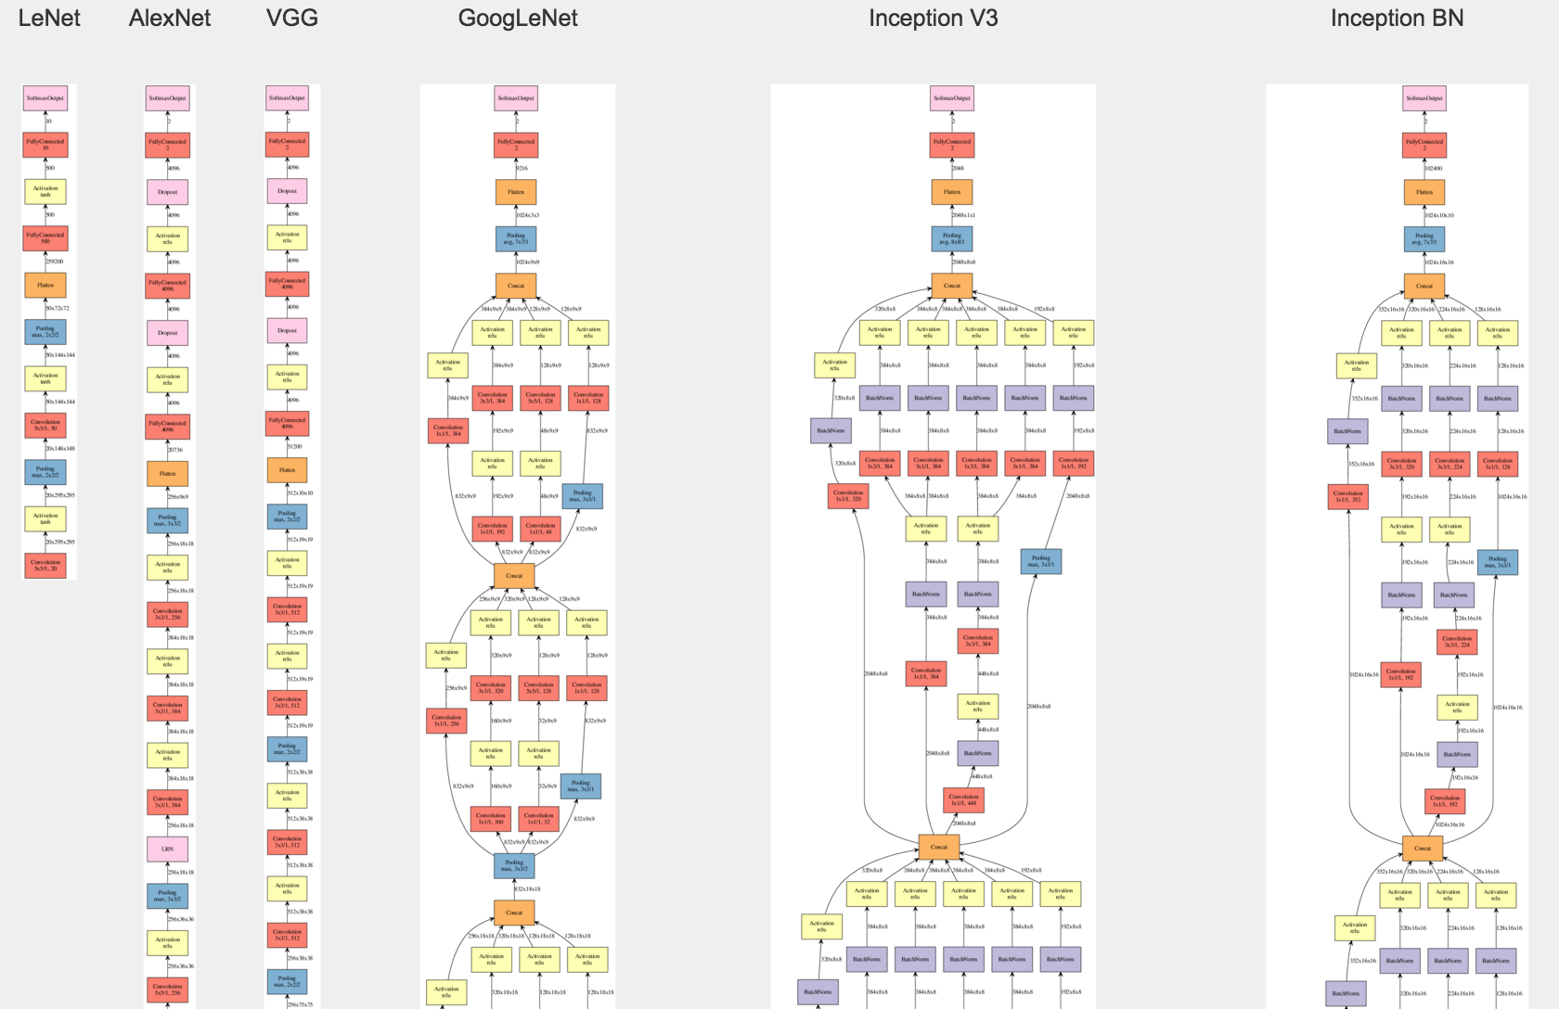
Famous CNN Architectures

Slide 9
Questions / Discussion
Notes:
It’s important to keep in mind why you joined this class. Let’s talk about your goals.

